Slide 1
Testing Applications and
Security Engineering
Session 17 - 18
Course : COMP6100/Software Engineering
Effective Period : Desember 2017

Slide 2
These slides have been adapted from
Pressman, R.S. (2015). Software Engineering : A Practioner's Approach. 8th ed. McGraw-Hill Companies.Inc, Americas, New York. ISBN 978 1 259 253157. Chapter 23, 24, 25, 26, and 27
Acknowledgement

Slide 3
LO 3 : Demonstrate the quality assurances and the potential showcase business project
Learning Objectives

Slide 4
Contents
Testing Conventional Applications
Testing Object Oriented Applications
Testing Web Applications
Testing Mobile Applications
Security Engineering

Slide 5
Software Testing Fundamentals : Testability
Testing Conventional Applications
Operability —it operates cleanly
Observability —the results of each test case are readily observed
Controllability —the degree to which testing can be automated and optimized
Decomposability —testing can be targeted
Simplicity —reduce complex architecture and logic to simplify tests
Stability —few changes are requested during testing
Understandability —of the design

Slide 6
What is a “Good” Test?
Testing Conventional Applications
A good test has a high probability of finding an error
A good test is not redundant.
A good test should be “best of breed”
A good test should be neither too simple nor too complex

Slide 7
Testing Conventional Applications
Internal and External Views of Testing
Any engineered product (and most other things) can be tested in one of two ways:
  Knowing the specified function that a product has been designed to perform, tests can be conducted that demonstrate each function is fully operational while at the same time searching for errors in each function;
  Knowing the internal workings of a product, tests can be conducted to ensure that "all gears mesh," that is, internal operations are performed according to specifications and all internal components have been adequately exercised.

Slide 8
Test Case Design
Testing Conventional Applications
"Bugs lurk in corners
and congregate at
boundaries ..."
Boris Beizer
OBJECTIVE
to uncover errors
CRITERIA
in a complete manner
CONSTRAINT
with a minimum of effort and time

Slide 9
Exhaustive Testing
Testing Conventional Applications
loop < 20 X
14
There are 10 possible paths! If we execute one
test per millisecond, it would take 3,170 years to
test this program!!

Slide 10
Selective Testing
Testing Conventional Applications
Selected path
loop < 20 X

Slide 11
Software Testing
Testing Conventional Applications
white-box
methods
black-box
methods
Methods
Strategies

Slide 12

Testing Conventional Applications
White-Box Testing
... our goal is to ensure that all
statements and conditions have
been executed at least once ...

Slide 13
White-Box Testing
Testing Conventional Applications
logic errors and incorrect assumptions
are inversely proportional to a path's
execution probability
we often
believe
that a path is not
likely to be executed; in fact, reality is
often counter intuitive
typographical errors are random; it's
likely that untested paths will contain
some

Slide 14
Testing Conventional Applications
Basis Path Testing
First, we compute the cyclomatic
complexity:
or
number of enclosed areas + 1
In this case, V(G) = 4

Slide 15
Cyclomatic Complexity
Testing Conventional Applications
A number of industry studies have indicated
that the higher V(G), the higher the probability
or errors.
modules
V(G)
modules in this range are
more error prone

Slide 16
Testing Conventional Applications
Basis Path Testing
1
Next, we derive the
independent paths:
2
Since V(G) = 4,
there are four paths
3
Path 1: 1,2,3,6,7,8
4
Path 2: 1,2,3,5,7,8
5
6
Path 3: 1,2,4,7,8
Path 4: 1,2,4,7,2,4,...7,8
Finally, we derive test
7
cases to exercise these
paths.
8

Slide 17
Basis Path Testing Notes
Testing Conventional Applications
you don't need a flow chart,
but the picture will help when
you trace program paths
count each simple logical test,
compound tests count as 2 or
more
basis path testing should be
applied to critical modules

Slide 18
Basis Path Testing - Graph Matrices
Testing Conventional Applications
A graph matrix is a square matrix whose size (i.e., number of rows and columns) is equal to the number of nodes on a flow graph
Each row and column corresponds to an identified node, and matrix entries correspond to connections (an edge) between nodes.
By adding a link weight to each matrix entry, the graph matrix can become a powerful tool for evaluating program control structure during testing

Slide 19
Testing Conventional Applications
Control Structure Testing
Condition testing — a test case design method that exercises the logical conditions contained in a program module
Data flow testing — selects test paths of a program according to the locations of definitions and uses of variables in the program

Slide 20
Loop Testing
Testing Conventional Applications
Simple
loop
Nested
Loops
Concatenated
Loops
Unstructured
Loops

Slide 21
Testing Conventional Applications
Black-Box Testing
requirements
output
input
events

Slide 22
Testing Conventional Applications
Black-Box Testing
How is functional validity tested?
How is system behavior and performance tested?
What classes of input will make good test cases?
Is the system particularly sensitive to certain input values?
How are the boundaries of a data class isolated?
What data rates and data volume can the system tolerate?
What effect will specific combinations of data have on system operation?

Slide 23
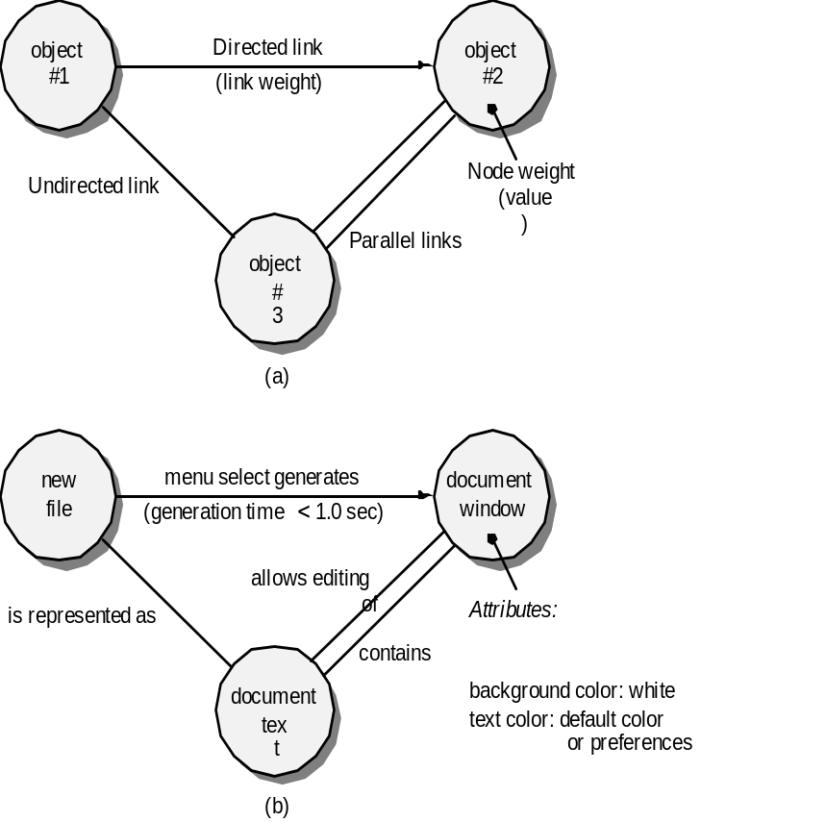
Graph-Based Methods
Testing Conventional Applications
To understand the objects that are modeled in software and the relationships that connect these objects
In this context, we consider the term “objects” in the broadest possible context. It encompasses data objects, traditional components (modules), and object-oriented elements of computer software.

Slide 24
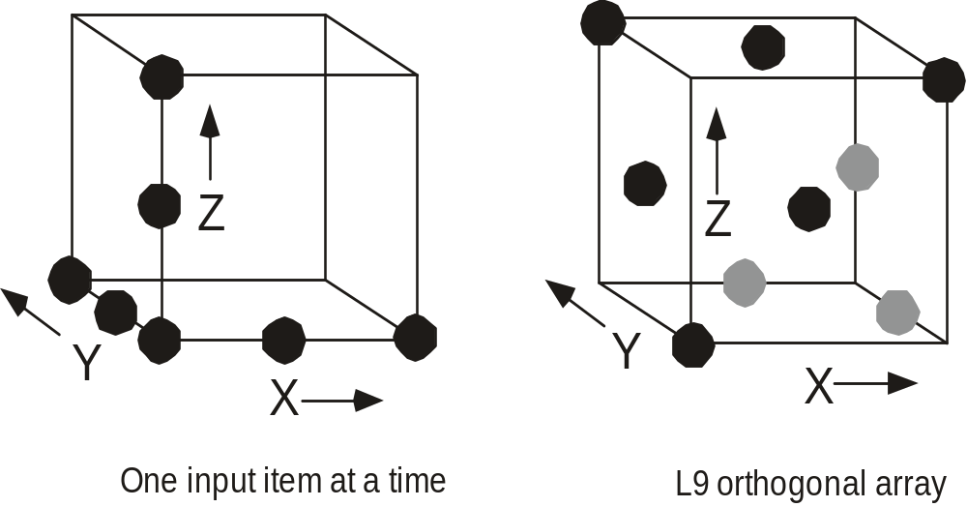
Orthogonal Array Testing
Testing Conventional Applications
Used when the number of input parameters is small and the values that each of the parameters may take are clearly bounded

Slide 25
Testing Object Oriented Application
To adequately test OO systems, three things must be done:
  the definition of testing must be broadened to include error discovery techniques applied to object-oriented analysis and design models
  the strategy for unit and integration testing must change significantly, and
  the design of test cases must account for the unique characteristics of OO software.

Slide 26
‘Testing’ OO Models
Testing Object Oriented Application
The review of OO analysis and design models is especially useful because the same semantic constructs (e.g., classes, attributes, operations, messages) appear at the analysis, design, and code level
Therefore, a problem in the definition of class attributes that is uncovered during analysis will circumvent side affects that might occur if the problem were not discovered until design or code (or even the next iteration of analysis).

Slide 27
Correctness of OO Models
Testing Object Oriented Application
During analysis and design, semantic correctness can be asesssed based on the model’s conformance to the real world problem domain.
If the model accurately reflects the real world (to a level of detail that is appropriate to the stage of development at which the model is reviewed) then it is semantically correct.
To determine whether the model does, in fact, reflect real world requirements, it should be presented to problem domain experts who will examine the class definitions and hierarchy for omissions and ambiguity.
Class relationships (instance connections) are evaluated to determine whether they accurately reflect real-world object connections.

Slide 28
Class Model Consistency
Testing Object Oriented Application
Revisit the CRC model and the object-relationship model.
Inspect the description of each CRC index card to determine if a delegated responsibility is part of the collaborator’s definition.
Invert the connection to ensure that each collaborator that is asked for service is receiving requests from a reasonable source.
Using the inverted connections examined in the preceding step, determine whether other classes might be required or whether responsibilities are properly grouped among the classes.
Determine whether widely requested responsibilities might be combined into a single responsibility.

Slide 29
OO Testing Strategies
Testing Object Oriented Application
Unit testing
  the concept of the unit changes
  the smallest testable unit is the encapsulated class
  a single operation can no longer be tested in isolation (the conventional view of unit testing) but rather, as part of a class
Integration Testing
  Thread-based testing integrates the set of classes required to respond to one input or event for the system
  Use-based testing begins the construction of the system by testing those classes (called independent classes) that use very few (if any) of server classes. After the independent classes are tested, the next layer of classes, called dependent classes
  Cluster testing defines a cluster of collaborating classes (determined by examining the CRC and object-relationship model) is exercised by designing test cases that attempt to uncover errors in the collaborations.

Slide 30
OO Testing Strategies
Testing Object Oriented Application
Validation Testing
  details of class connections disappear
  draw upon use cases that are part of the requirements model
  Conventional black-box testing methods can be used to drive validation tests

Slide 31
OOT Methods
Testing Object Oriented Application
Berard [Ber93] proposes the following approach:
Each test case should be uniquely identified and should be explicitly associated with the class to be tested
The purpose of the test should be stated.
A list of testing steps should be developed for each test and should contain:
  a list of specified states for the object that is to be tested
  a list of messages and operations that will be exercised as a on sequence of the test
  a list of exceptions that may occur as the object is tested
  a list of external conditions (i.e., changes in the environment external to the software that must exist in order to properly conduct the test)
  supplementary information that will aid in understanding or implementing the test.

Slide 32
Testing Methods
Testing Object Oriented Application
Fault-based testing
  The tester looks for plausible faults (i.e., aspects of the implementation of the system that may result in defects). To determine whether these faults exist, test cases are designed to exercise the design or code.
Class Testing and the Class Hierarchy
  Inheritance does not obviate the need for thorough testing of all derived classes. In fact, it can actually complicate the testing process.
Scenario-Based Test Design
  Scenario-based testing concentrates on what the user does, not what the product does. This means capturing the tasks (via use-cases) that the user has to perform, then applying them and their variants as tests.

Slide 33
OOT Methods: Random Testing
Testing Object Oriented Application
Random testing
  identify operations applicable to a class
  define constraints on their use
  identify a minimum test sequence
    an operation sequence that defines the minimum life history of the class (object)
  generate a variety of random (but valid) test sequences
    exercise other (more complex) class instance life histories

Slide 34
OOT Methods: Partition Testing
Testing Object Oriented Application
Partition Testing
  reduces the number of test cases required to test a class in much the same way as equivalence partitioning for conventional software
  state-based partitioning
    categorize and test operations based on their ability to change the state of a class
  attribute-based partitioning
    categorize and test operations based on the attributes that they use
  category-based partitioning
    categorize and test operations based on the generic function each performs

Slide 35
OOT Methods: Inter-Class Testing
Testing Object Oriented Application
Inter-class testing
  For each client class, use the list of class operators to generate a series of random test sequences. The operators will send messages to other server classes.
  For each message that is generated, determine the collaborator class and the corresponding operator in the server object.
  For each operator in the server object (that has been invoked by messages sent from the client object), determine the messages that it transmits.
  For each of the messages, determine the next level of operators that are invoked and incorporate these into the test sequence

Slide 36
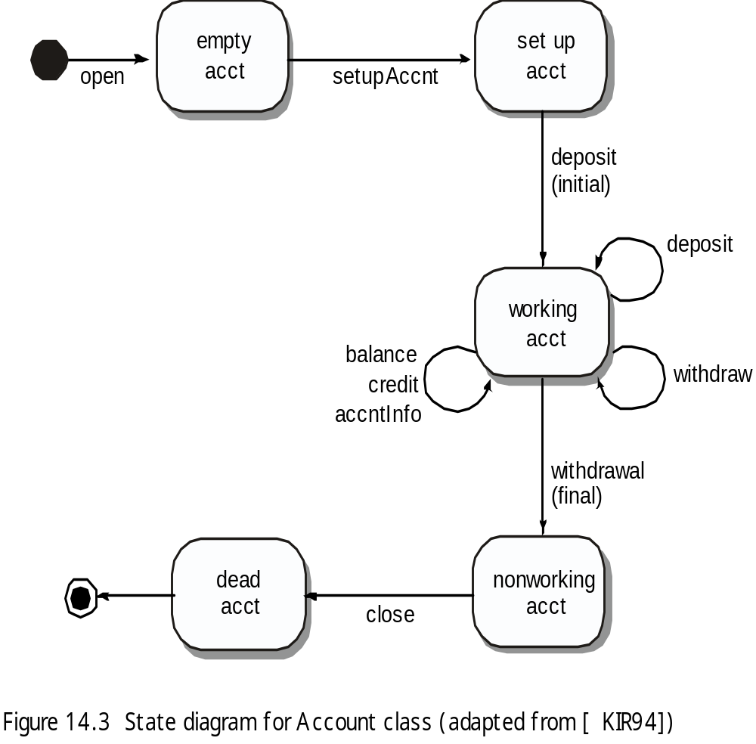
OOT Methods: Behavior Testing
Testing Object Oriented Application
The tests to be designed should achieve all state coverage [KIR94].
That is, the operation sequences should cause the account class to make transition through all allowable states

Slide 37
Testing Web Applications
Testing Quality Dimensions-I
Content is evaluated at both a syntactic and semantic level.
  syntactic level
  semantic level
Function is tested for correctness, instability, and general conformance to appropriate implementation standards (e.g.,Java or XML language standards).
Structure is assessed to ensure that it
  properly delivers WebApp content and function
  is extensible
  can be supported as new content or functionality is added.
Usability is tested to ensure that each category of user
  is supported by the interface
  can learn and apply all required navigation syntax and semantics
Navigability is tested to ensure that
  all navigation syntax and semantics are exercised to uncover any navigation errors (e.g., dead links, improper links, erroneous links).

Slide 38
Testing Web Applications
Testing Quality Dimensions-II
Performance is tested under a variety of operating conditions, configurations, and loading to ensure that
  the system is responsive to user interaction
  the system handles extreme loading without unacceptable operational degradation
Compatibility is tested by executing the WebApp in a variety of different host configurations on both the client and server sides.
  The intent is to find errors that are specific to a unique host configuration.
Interoperability is tested to ensure that the WebApp properly interfaces with other applications and/or databases.
Security is tested by assessing potential vulnerabilities and attempting to exploit each.
  Any successful penetration attempt is deemed a security failure.

Slide 39
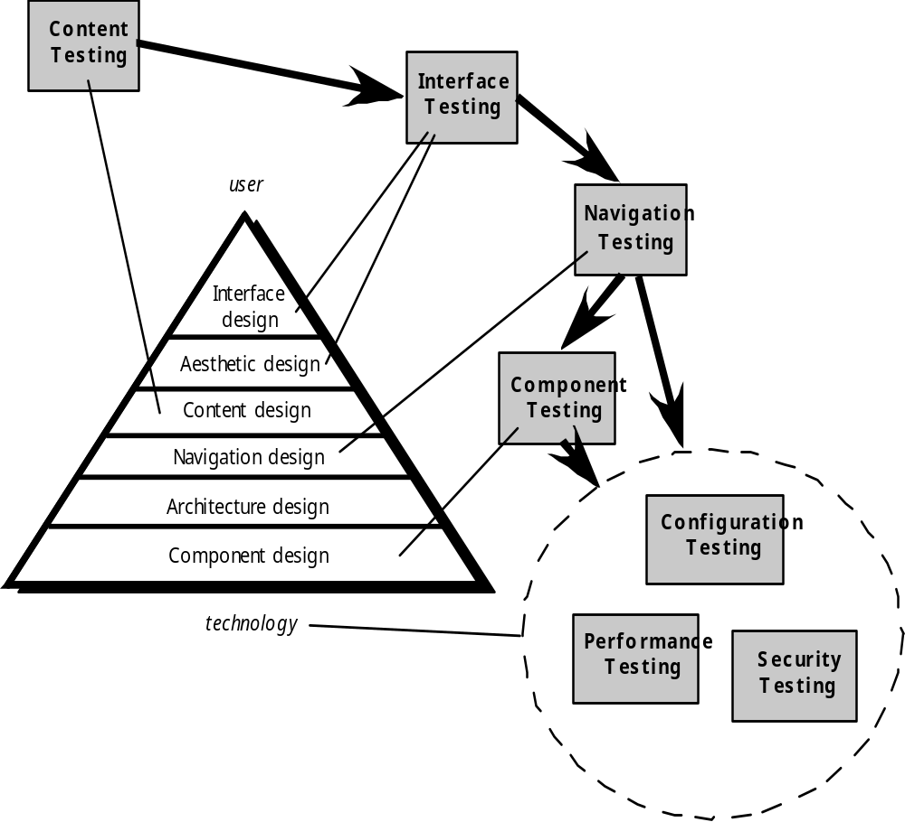
The Testing Process
Testing Web Applications

Slide 40
Content Testing
Testing Web Applications
Content testing has three important objectives:
  to uncover syntactic errors (e.g., typos, grammar mistakes) in text-based documents, graphical representations, and other media
  to uncover semantic errors (i.e., errors in the accuracy or completeness of information) in any content object presented as navigation occurs, and
  to find errors in the organization or structure of content that is presented to the end-user.

Slide 41
Testing Web Applications
Assessing Content Semantics
Is the information factually accurate?
Is the information concise and to the point?
Is the layout of the content object easy for the user to understand?
Can information embedded within a content object be found easily?
Have proper references been provided for all information derived from other sources?
Is the information presented consistent internally and consistent with information presented in other content objects?
Is the content offensive, misleading, or does it open the door to litigation?
Does the content infringe on existing copyrights or trademarks?
Does the content contain internal links that supplement existing content? Are the links correct?
Does the aesthetic style of the content conflict with the aesthetic style of the interface?

Slide 42
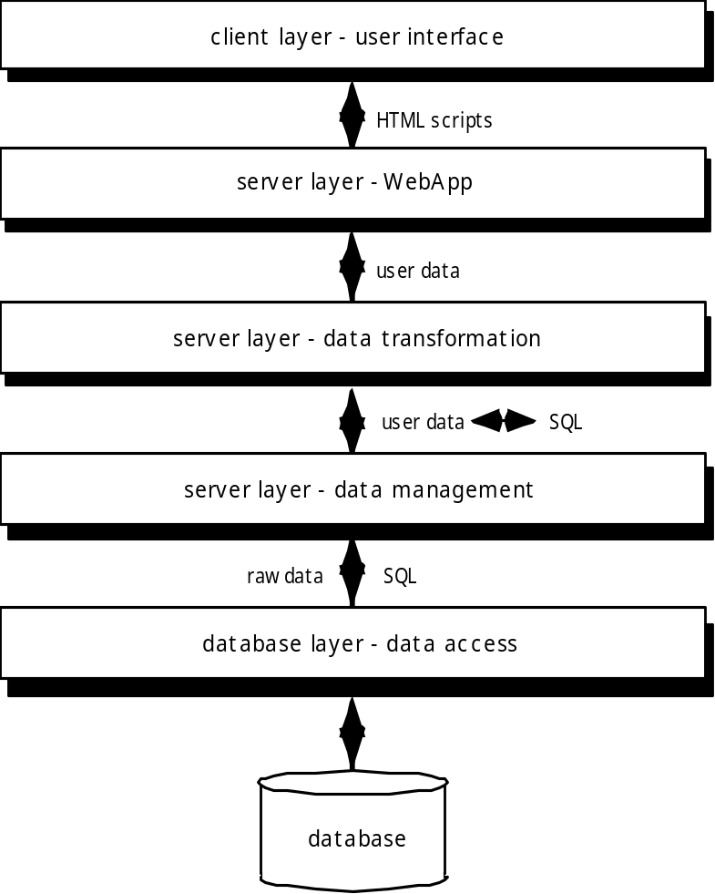
Testing Web Applications
Database Testing
Tests are defined for
each layer

Slide 43
User Interface Testing
Testing Web Applications
Interface features are tested to ensure that design rules, aesthetics, and related visual content is available for the user without error.
Individual interface mechanisms are tested in a manner that is analogous to unit testing.
Each interface mechanism is tested within the context of a use-case or NSU for a specific user category.
The complete interface is tested against selected use-cases and NSUs to uncover errors in the semantics of the interface.
The interface is tested within a variety of environments (e.g., browsers) to ensure that it will be compatible.

Slide 44
Testing Guidelines
Testing Mobile Applications
Understand the network and device landscape before testing to identify bottlenecks
Conduct tests in uncontrolled real-world test condition (filed-based testing)
Select the right automation test tool
Use the Weighted Device Platform Matrix method to identify the most critical hardware/platform combination to test
Check the end-to-end functional flow in all possible platforms at least once
Conduct performance testing, GUI testing, and compatibility testing using actual devices
Measure performance only in realistic conditions of wireless and user load

Slide 45
Testing Strategies
Testing Mobile Applications
Developing a MobileApp testing strategy requires an understanding of both software testing and the challenges that make mobile devices and their network infrastucture unique.
In addition to a thorough knowledge of conventional software testing approach, a MobileApp tester should have a good understanding of telecommunications principles and an awarness of the differences and capabilities of mobile operating systems platforms.
This basic knowledge must be complemented with a thorough understanding of the different types of mobile testing (e.g. MobileApp testing, mobile handset testing, mobile website testing), the use of simulators, test automations tools, and remote data access services (RDA).

Slide 46
Criteria Testing Tools and Environments
Testing Mobile Applications
Object identification
Security
Devices
Functionality
Emulators and plug-ins
Connectivity

Slide 47
Analyzing Security Requirements
Security Engineering
An important part of building secure systems is anticipating conditions or threats that may be used to damage system resources or render them inaccessible to authorized users.
This process is called threat analysis.
Once the system assets, vulnerabilities, and threats have been identified, controls can be created to either avoid attacks or mitigate their damage.

Slide 48
Analyzing Security Requirements
Security Engineering
Software security is an essential prerequisite for software integrity, availability, reliability, and safety
It may not possible to create a system that can be defend its assets againt all possible threats, and for that reason, it may be necessary to encourage users to maintain backup copies of critical data, redundant system component, and ensure privacy controls are in place

Slide 49
Security and Privacy in an Online World
Security Engineering
Social Media
Mobile Applications
Cloud Computing
The Internet of Things

Slide 50
Security Risk Analysis
Security Engineering
Identify assets
Create an architecture overview
Decompose the application
Identify threats
Documented the threats
Rate the threats

Slide 51
References
Pressman, R.S. (2015). Software Engineering : A Practioner's Approach. 8th ed. McGraw-Hill Companies.Inc, Americas, New York. ISBN : 978 1 259 253157.
Software Testing, http://www.youtube.com/watch?v=caElFKbceP0&list=PLED41984073D5B532
Conventional sw testing http://www.testingexcellence.com/conventional-software-testing-on-an-extreme-programming-team/
Testing OO SW
http://diwww.epfl.ch/researchlgl/research/ongoing/testing.html
Web testing
http://www.manageengine.com/products/qengine/web-testing.html

Slide 52
Q & A

